Slide 1



Lessons Learned: ComputinG Alliance of Hispanic-Serving Institutions
May 15, 2023
Ann Quiroz Gates
Senior Advisor to the Provost Strategic STEM Initiatives
University of Texas at El Paso
Director of the Computing Alliance of Hispanic-Serving Institutions
HRD-1834620
CNS- 1551221
HSRU Summit

Slide 2
Eddie Bernice Johnson INCLUDES Initiative
NSF INCLUDES
A comprehensive national initiative designed to enhance U.S. leadership in STEM discoveries and innovations by focusing on broadening participation in STEM fields at scale.
CAHSI INCLUDES
Mission
Grow and sustain a networked community committed to recruiting, retaining, and accelerating the progress of Hispanics in computing.

Slide 3
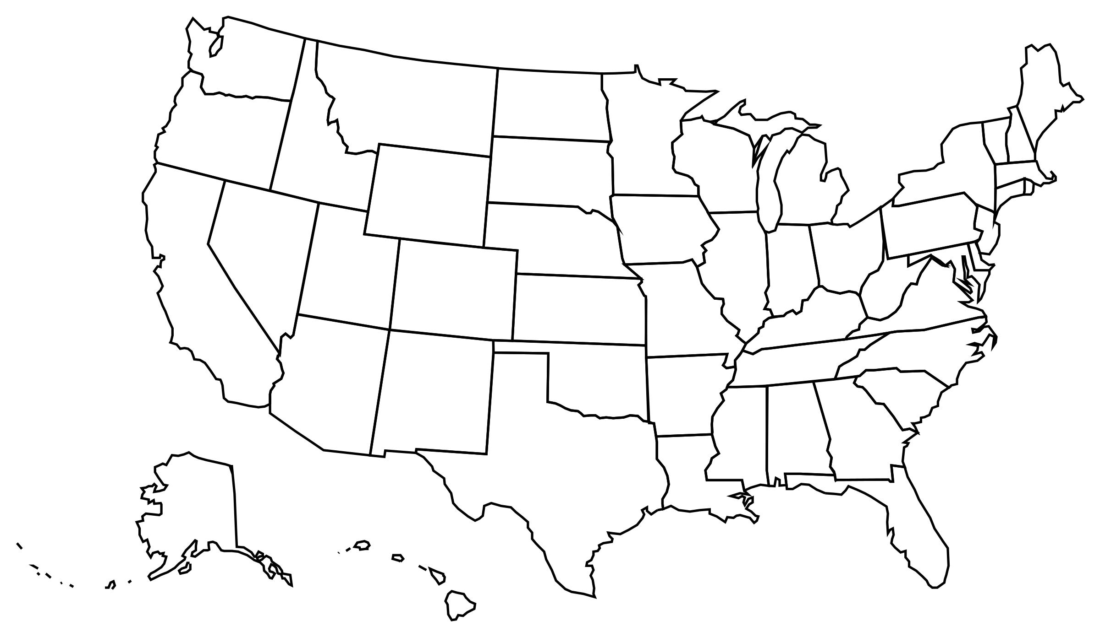
Alliance Overview
CAHSI’s Vision
By 2030, Hispanics will represent 20% or more of those who earn credentials in computing.
CAHSI Goals
Challenge students’ knowledge, skills, and abilities (KSA)s to position them to thrive in the workforce and academia.
Support professional growth for those who serve Hispanics
Expand meaningful partnerships
Inform policy through evidence
HRD-1834620
CNS- 1551221

Slide 4

CAHSI’s Growth over the years

Slide 5
CAHSI formed to address underrepresentation of Hispanics in computing.
2006-2016
Funded by NSF Broadening Participation in Computing (BPC) program
Started with seven 4-year HSIs
Focused on institutional effective practices and their transferability:
Affinity Research Group (ARG) model
Peer-Led Team Learning (PLTL)
Fellow-Net
CS-0 (Computational Thinking)
Primary focus: UG programs

Slide 6
CAHSI becomes an NSF INCLUDES alliance.
2018-
Adopts Collective Impact framework.
Extends membership to 2-year colleges.
Grows to 90 HSIs.
Involves approximately over 70 partners.
Adds Google-CAHSI problem-solving courses as a signature practice.
Outlines Hispanic-Servingness multi-dimensional support structures
Focus: Development of a collaborative infrastructure

Slide 7

Collaborative Infrastructure Design Elements
Shared Vision
Partnerships
Goals and Metrics
Leadership and Communication
Expansion, Sustainability, and Scale

Slide 8
Role of the Backbone
Guide the vision and strategy for the Alliance and plan for the future. (Shared Vision, Expansion, Goals and Metrics, Sustainability)
Align activities and continuous improvement efforts of the nationally networked community (Partnerships, Goals and Metrics)
Build the capacity and identify of CAHSI institutions and Hispanic students to further the advance next generation of Hispanic computer scientists. (Leadership and Communication)
Serve as a national resource for building public will to advance Hispanics in computing (Expansion, Sustainability)

Slide 9
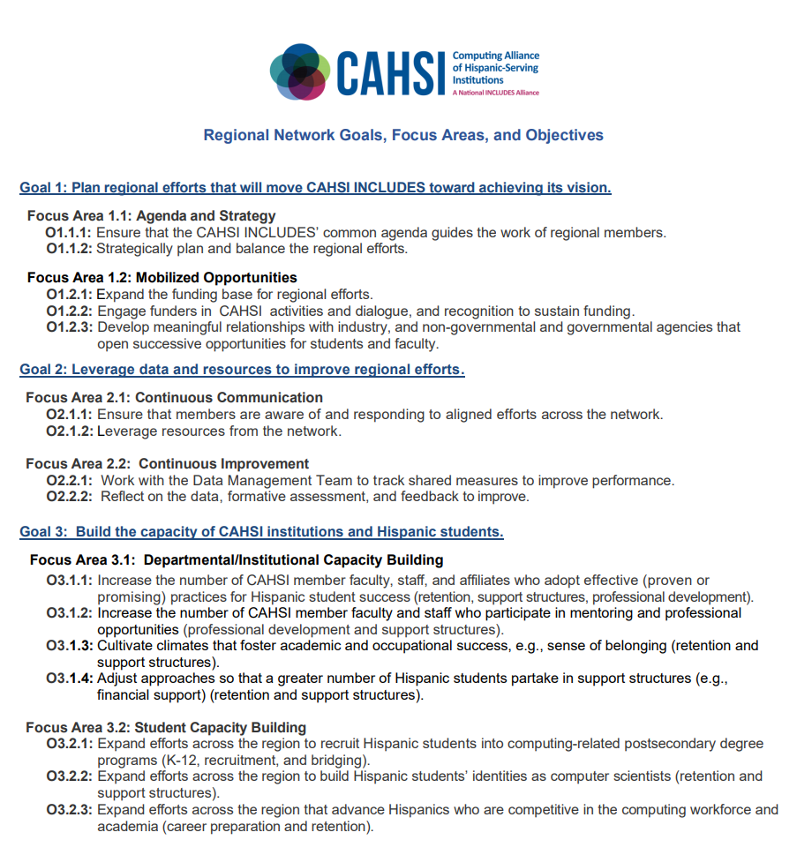
Backbone and Regional Visioning Documents:
Operationalizing Goals and Strategic Actions

Slide 10
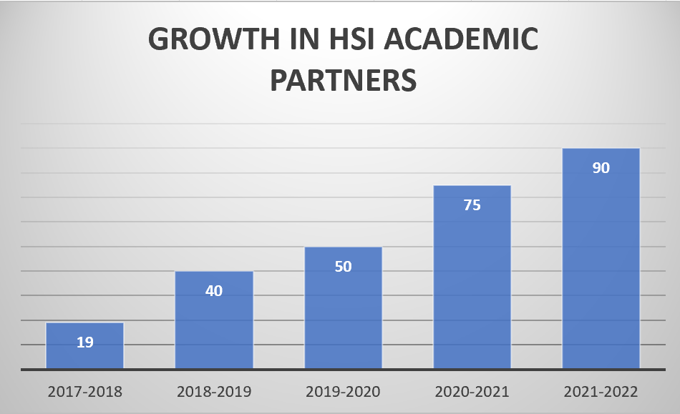
CAHSI Communication and Scalability
Backbone
Regional Hubs
All-Hands Meetings
Engage partners
Share assets
Coordinate efforts
Discuss challenges
Learn from others
On-Boarding Meetings
Memorandum of Understanding
Align w/ mission and goals
Commit to data-driven decision making
Develop a strategic plan
Shared agenda:vision & mission
Institutional capacity building
Student capacity building
Assessment and evaluation

Slide 11
Leadership and Communication
Faculty
  Distributed leadership model—regional decision making and contributions to national efforts
  Curriculum changes in response to industry gaps (e.g., MCCCD, CSU-Stan; Kean U, UPRM, UTEP, Merced College)
  Numerous collaborative proposal submissions and awards, e.g., Kean’s Consortium S-STEM grant focused on cybersecurity and data science
Staff
  Regular meetings to offer direction, build knowledge, & facilitate group innovation
  Addition of specialized personnel to advance Hispanic student success (e.g., NMSU, UTEP)
Students
  Advocates
  Scholars
Notes:
https://www.maricopa.edu/degrees-certificates/computer-information-technology/cybersecurity-3197-aas
Per Evaluation from Creative Research Solutions on the Advocates, Scholars, Allyship Programs:
Knowledge of Social Impact (pg. 3)
Under Leadership -- our CAHSI North Meetings have addressed topics at our meeting during the past year such as:
-- teaching during COVID; best practices and lessons learned.
-- developing cybersecurity degrees and programs
-- problem solving courses
-- developing a research environment at primarily undergraduate schools
From Nayda SE -- we followed her model of success to obtain Google eCSR grants for the past 3 years (2019, 2020, 2021). With the funding, we have hosted national CAHSI events, with virtual webinars, in 2020 and 2021. 2019 was in-person.
From others in CAHSI, esp. Enrico SW -- we built on our two prior S-STEM grants and led a consortium of 5 schools for North (Kean, NJIT, FDU, Brookdale, and UCC) which resulted in a funded S-STEM grant, focused on cybersecurity and data science. CASHI
MOUs to follow from NJIT, FDU and UCC.
● Across Programs
○ All students increased in their beliefs that computing has a social impact and
can help others.
● Allyship
○ See “Across Programs”.
● Advocates
○ See “Across Programs”.
● Scholars
○ See “Across Programs”.
Self-Efficacy/Confidence (pg.4)
● Across Programs
○ Average responses increased from neither agreed nor disagreed about their
confidence at Baseline to slightly more agreement at T1.
● Allyship
○ Allyship students felt confident to complete a computer degree.
● Advocates
○ Advocates felt confident to complete a computer degree.
● Scholars
○ Scholars had slightly more agreement at Baseline compared to the other
programs for feeling confident in communicating technical problems, quickly
learning a new programming language, becoming a leader in computing.

Slide 12
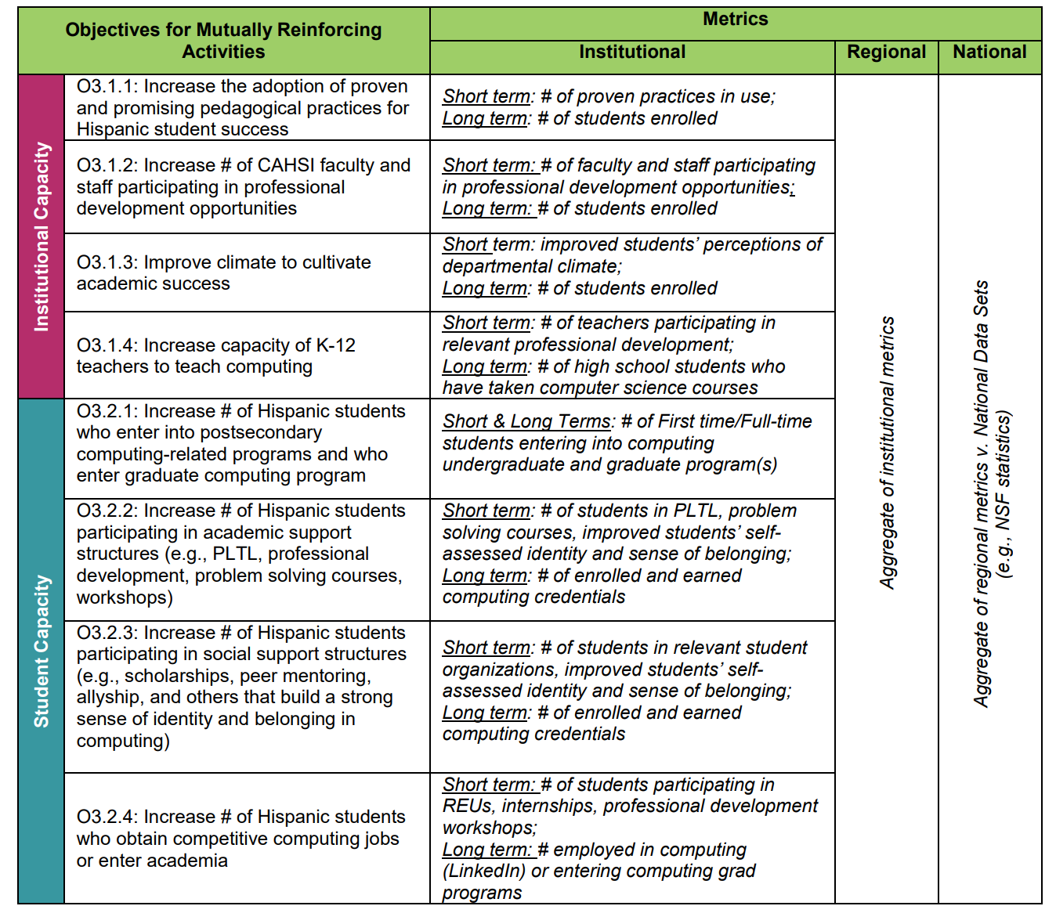
Common Measures

Slide 13
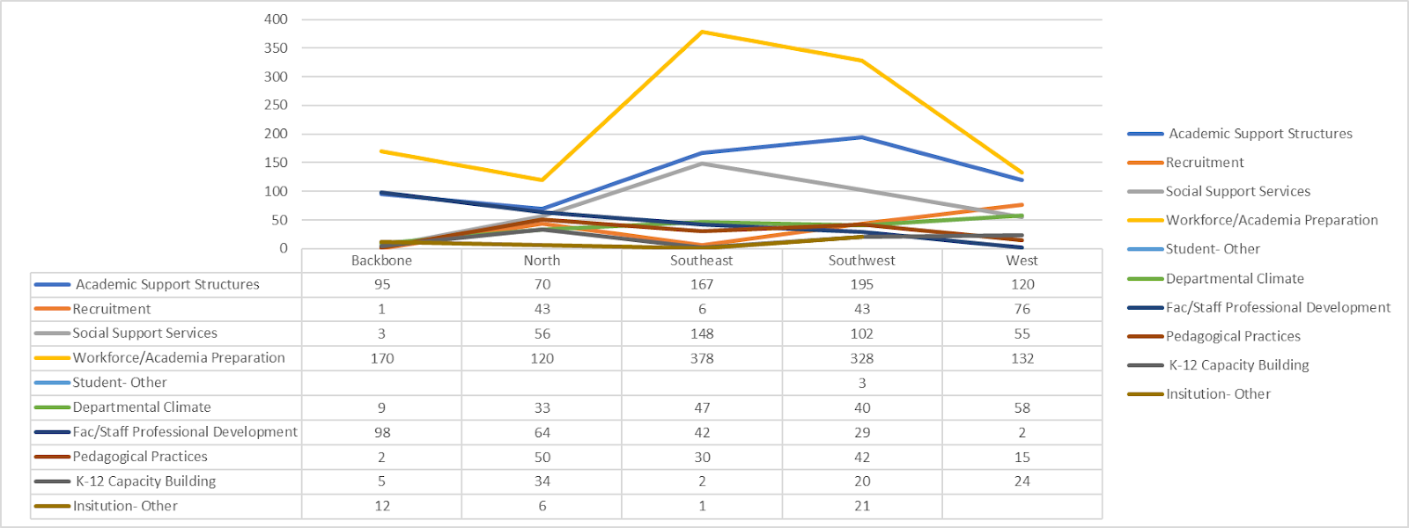
Reporting Mechanism:
CAHSI Engage Tool
Aligns strategic actions to the CAHSI Visioning documents
Maps strategic actions to objectives focused on Capacity Building
Tracks activities associated with strategic actions and focus areas.
Activities by Focus Area, 2017-2022

Slide 14
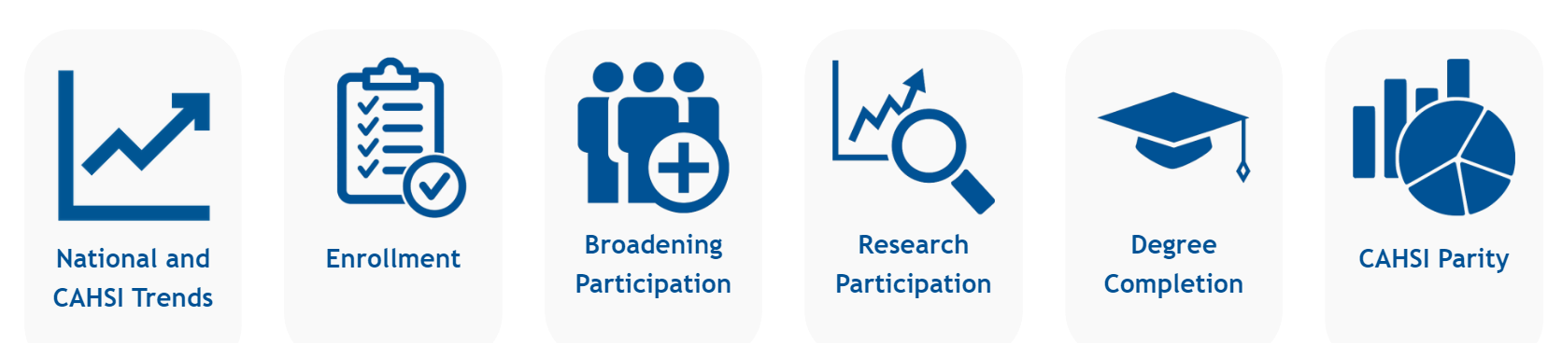
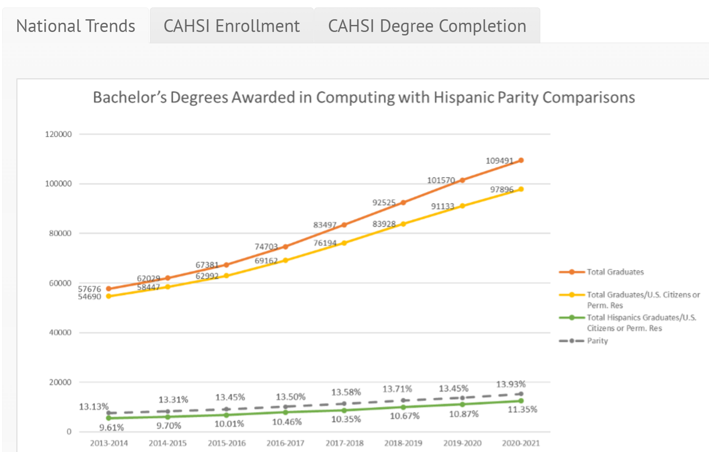
Data Dashboard

Slide 15
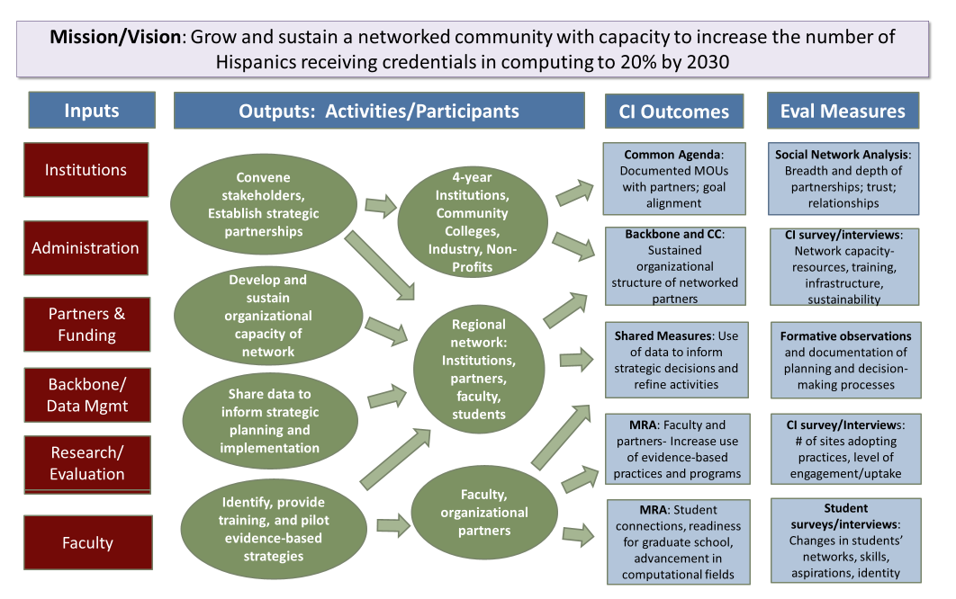
Evaluation Team: Logic Model
Notes:
Transition to evaluation

Slide 16
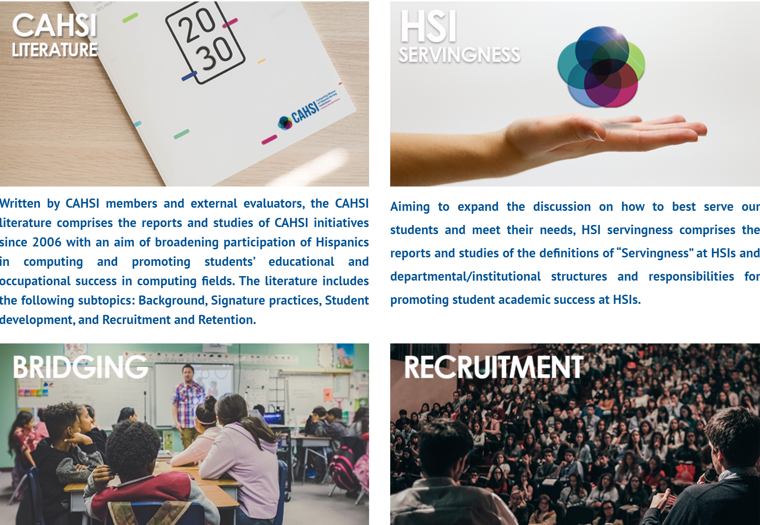

Dissemination:
CAHSI Library
http://cahsi.org

Slide 17
CAHSI focuses on graduate degree attainment.
2021: Receives funding from NSF BPC-AE program
Extending focus to pathways to graduate programs.
Connecting 10 R1 HSIs to CAHSI.
2022: Receives funding from Sloan Foundation
Expanding the NSF BPC-AE efforts
Focusing on research support structures
Engaging administrators and promoting data- and knowledge decision making
2022: Receives funding from Google
Supporting programming for 1st and 2nd year students
Funding local REUs
Creating CAHSI-Google Collaborative Research Initiative
Providing Dissertation Scholarship for students in their last year and going into academia
Engaging researchers through Ideation workshops

Slide 18

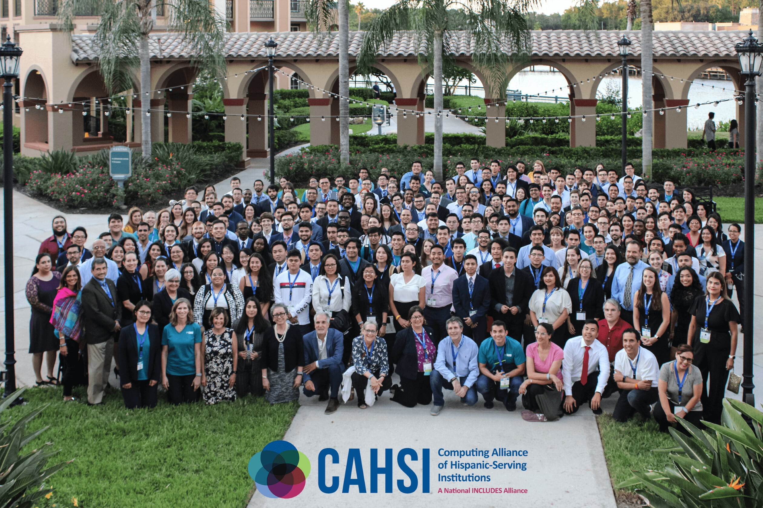
Thank you!
cahsi.org
agates@utep.edu

